Slide 1
A survery of peer to peer content distribution technologies
Heymo Kou

Slide 2
Contents
Content caching, replication & migration
Security
Provisions for anonymity
Provisions for deniability
Incentive mechanisms and accountability
Resource management capabilities
Semantic grouping of information

Slide 3
Content caching, replication & migration
Passive Replication - Napster
Cache-Based Replication
Active Replication -
Introspective replica management - OceanStore, MojoNation, Scan & Gnutella
Watch traffic and manage replica
Endures DDOS

Slide 4
Content caching, replication & migration
Dynamic replica management
Data consistency & synchronization is always an issue
especially when deletion and update is allowed
Some weaken their consistency restriction
For Chord, replication is challenging
Since objects' location is mapped with object identifiers

Slide 5
Security
Securing storage is very important
Self-Certifying Data - Compare Key w/ hash function result
Information Dispersal - endcode files into m blocks
Redundancy factor = m / n
Shamir's Secret Sharing Scheme(SHA) - widely used
encrypts a file with a key K
split K into l shares
any k splits can reproduce K
but k - 1 splits cannot reproduce nor give any hint about K
For the file to become inaccessible
At least (l - k - 1) servers containing the key must shut down
(high fault-tolerant)

Slide 6
Security
Anonymous Cryptographic Relays - PAST
Role : Publisher, Forwarder, Storer & Clients
Publisher - select forwarders to send encrypted pieces
Forwarder - select random nodes for storing the shards & send them
Once all storers received the pieces publisher destroys the shares
Announce file name & list of forwarders
Client - Reach forwarders for the shares
Forwarders - request Storers to send the shares to client
Visible to potential attacker
BUT less likely to be attacked since forwarder don't store any content
Smartcards - Issue digitally signed tickets
Impractical to issue large number of nodes

Slide 7
Security
Distributed Steganographic File System
Encrypted blocks are indistinguishable
Randomly write blocks
Replace part of them with files in a pseudo-randomly chosen locations
Considerable amount of replication is required to avoid collisions
Erasure Coding
Data is broken in to blocks and spread over many servers
Only a fraction is needed to reconstruct the original block
Broken blocks named globally unique using a secure hash
Sybil Attack [Douceur, 2002]
P2P is exposed to attack unless a central certification or identification authority

Slide 8
Provisions for anonymity
Hiding information
Author(publisher), identity of nodes,
Identity of content itself, query for retrieval of the content
Disassociation of Content Source and Requestor - Freenet
Infeasible to discover the true origin or destination of a file
When a search for a file succeeds
Sends the file to previous search node and so on
Hops-to-live counter is randomly chosen

Slide 9
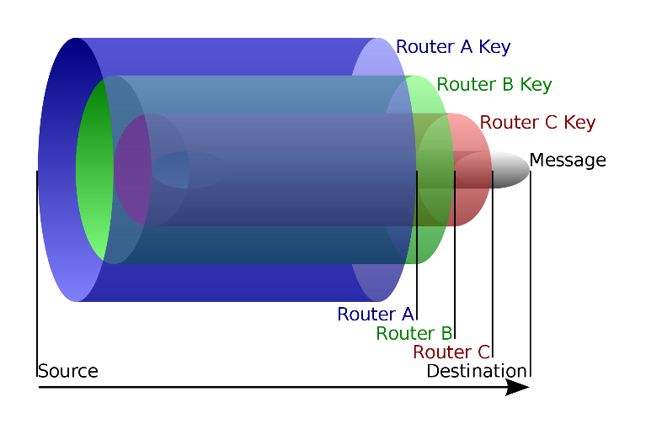
Provisions for anonymity
Anonymous Connection Layers - Onion routing
splits documents into encrypted shares
Use an anonymizing layer of nodes(forwarders)
Choose which nodes to store the shares
Construct "onions" around them
anonymously forward them
Tarzan system [Freedman et al. 2002]
completely decentralized anonymizing network
distributes anonymous IP tunnels between peers
Clients can communicate without leaking identity
Sequences of mix relays chosen from a large pool of volunteer nodes
Packets are routed through randomly chosen Tarzan peers
Performance is sacrificed

Slide 10
Provisions for deniability
Deniability of Stored Content
Stored encrypted shared of files does not offer any information without key
Deniability of Content in Transit
Offered through anonymous connection layers

Slide 11
Incentive mechanisms and accountability
Decentralized P2P system relies on voluntary participation
Providing incentives stimulates cooperative behavior
"Free-rider" - only consume resources without contributing
2 solutions
Trust-based incentive mechanisms / Reputation mechanisms
Trade-based incentive mechanisms
Offer service explicitly for contribution

Slide 12
Incentive mechanisms and accountability
Reputation mechanisms
Centralized reputation systems (i.e. eBay, Gmarket, Auction)
People trust reputation information presented by them
No organization manages the reputation information in P2P
Peers' reputation is spread out through the network
produce global reputation
Various reputation management algorithm
Eigen Trust algorithm [Kamvar et al. 2003]
Produces global reputation rating based on users' history of uploads
Rating can be used by others to decide where to download files from
Reduced the number of fake file / malware
Reputation computation agents [Gupta et al. 2003]
Partially centralized
Reputation data is stored at reputation agent

Slide 13
Incentive mechanisms and accountability
Feedback-based reputation mechanism [Xiong and Liu 2002]
Trust value for a peer is based on satisfaction received by other peers
Sun's JXTA [Jxta 2003]
Provides penalty to misbehaving nodes
Micropayments Mechanisms
Currency-based micropayment system
MojoNation [MojoNation 2003]
Mojo - currency gained by offering PC resources
Impractical for most applications [Buragohain et al. 2003]

Slide 14
Incentive mechanisms and accountability
Resource Trading Schemes
Transitive chains of peer transaction[Anagnostakis and Greenwald 2004]
node publishes digitally signed list of files
no node uses more resources than it is providing
balanced system is achieved
Flexible algorithm [Cooper and Garcia-Molina 2002]
Peers decide
how much data to trade
what resources to contribute
how many trades to make
Ensures fairness while maximizing content preservation
FreeHaven [Dingledin et al. 2000]
Contract - nodes store peer's material for a certain period of time
When fullfiled the contract, node's reputation increases
Contracts are formed when new data is inserted in the network
Each node maintains a database of other’s reputation

Slide 15
Resource management capabilities
Resources in P2P - content, storage & bandwidth
Basic operation in P2P - insertion, search & retrieval
Content Deletion and Update
MojoNation, PAST & FreeHaven applied immutable files
NO update allowed
Requires new version with different name for update
Publius offers both deletion and update of content
Only publisher will be able to delete / modify with password file
Content Expiration - FreeHaven
Content Versioning - OceanStore
Offers a version-based archival storage
OceanStore maintains active maps of document IDs
redirects to the most recent version on request

Slide 16
Resource management capabilities
Directory Structure - Mnemosyne
Manage as a whole
Entire distributed directory structure system
Content Searching
Unstructured systems - Gnutella, Kazaa & FreeHaven
Offer keyword-search mechanisms
do not scale
Structured systems
Very efficient in searching through file identifiers
Keyword search is still problem
One solution by Freenet
Use of indirect files - pointer of file
Name the indirect file with search keywords
Still managing in large volume situation remains unsolved

Slide 17
Semantic grouping of information
“Peer communities" [Khambatti et al. 2003]
Membership depends on the relationship between peers that share common interests
Efficient searching & better result
Communities are formed between peers that share similar attributes
Semantic overlay clustering [Loeser et al. 2003]
Creates logical layers above the physical network topology
Clusters with similar semantic profiles matched
Knowledge nodes [Bonifacio et al. 2002]
Each nodes can act as a seeker and/or provider
Seeker – allow user to search for information and forward queries
Provider – accepts and resolves the queries and return results

